Slide 1
Tom and Spike Classifier
TensorFlow Object Detection API
^{By: Ambuj Arora}

Slide 2

Ambuj Arora / Data Scientist
I have been into Data Science for the last two and half years and nothing excites me more! I love to research and explore new technologies revolving around Machine Learning. I have worked on Cryptocurrency Price Prediction, NLP, Computer Vision and Auto DL.

Slide 3

What is TensorFlow?
TensorFlow is an open-source machine learning library for research and production.
TensorFlow offers APIs for beginners and experts to develop for desktop, mobile, web, and cloud.
It performs numerical computations using tensors and data flow graphs.
Two Phases:
Construction Phase
Execution Phase

Slide 4

Agenda
Tensorflow overview
Neural Network overview
Object Detection Brief
Application and uses
Making of an Image Classifier
Setting up the directory structure
Preparing your custom data
Initialising the training
Detecting Objects on your custom data

Slide 5
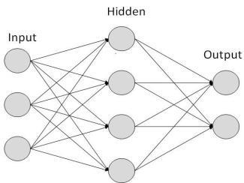
Neural Networks
General architecture
Input Layer
Hidden Layers
Output Layer

Slide 6
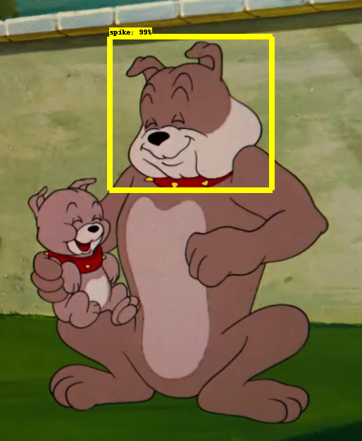
What is Object Detection?
Object detection involves detecting instances of objects from a particular class in an image.
Each detection is reported with some form of pose information.
location of the object
a bounding box

Slide 7
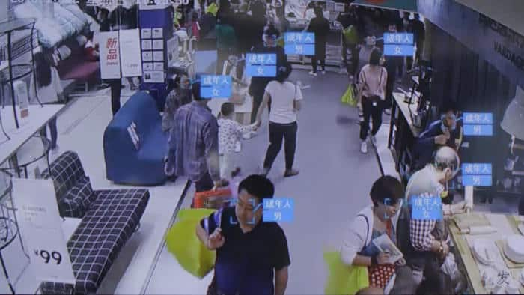
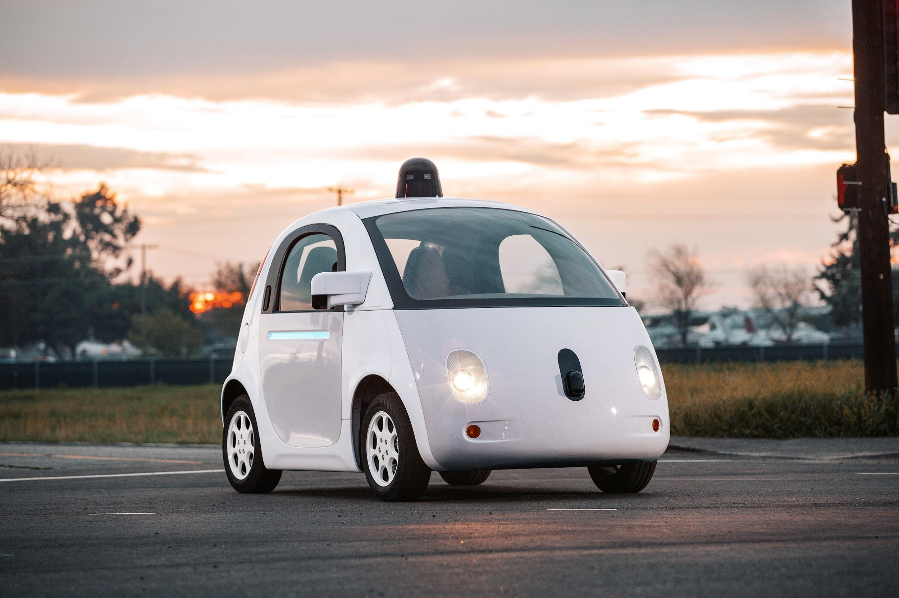
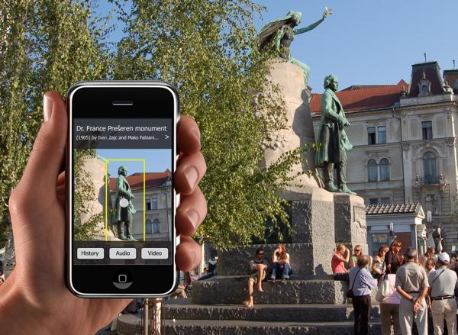
Applications and Uses
For surveillance and tracking trajectories of people in busy areas.
For self driving cars and vision-enabled robots or auto machines.
For educational and tourism purposes.
….and many more

Slide 8


The Characters
Class 1
Class 2
TOM
SPIKE

Slide 9
Overview
Step #01
Step #02
Setting up the directory structure
Preparing your custom data
Construction Phase
Step #03
Step #04
Execution Phase
Initialising the training
Detecting Objects on your custom data

Slide 10
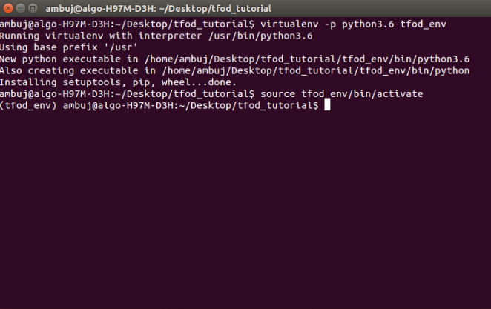
Setting up the directory structure
--virtualenv image--

Slide 11
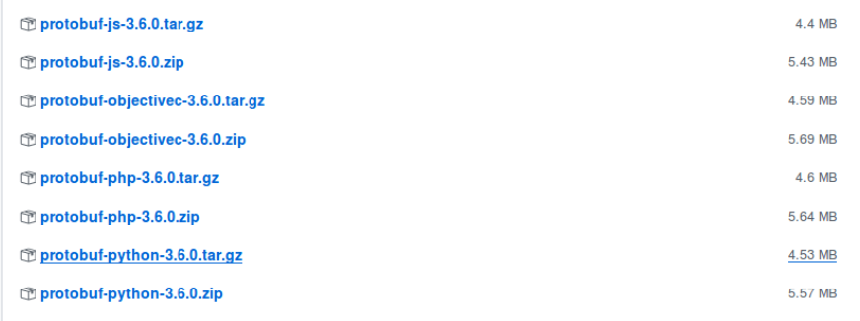
Setting up the directory structure
--virtualenv image--

Slide 12
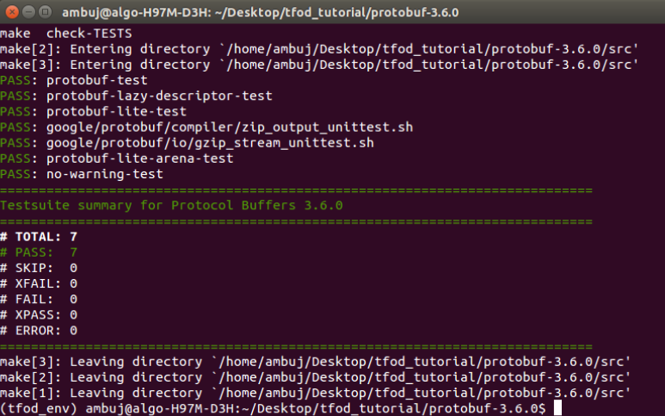
Setting up the directory structure
--prtobuf image--

Slide 13
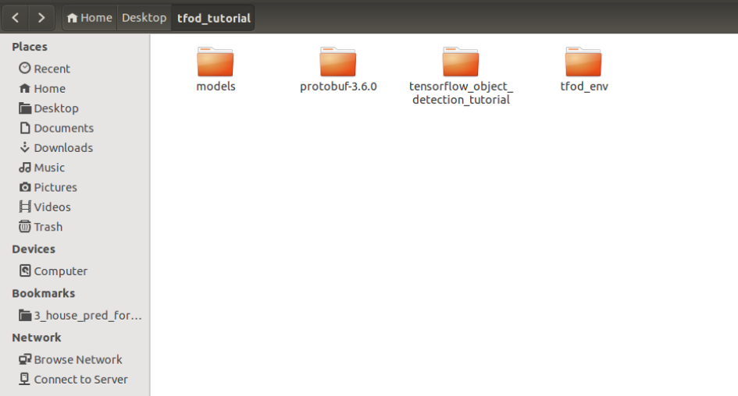
Setting up the directory structure
--directory structure--

Slide 14
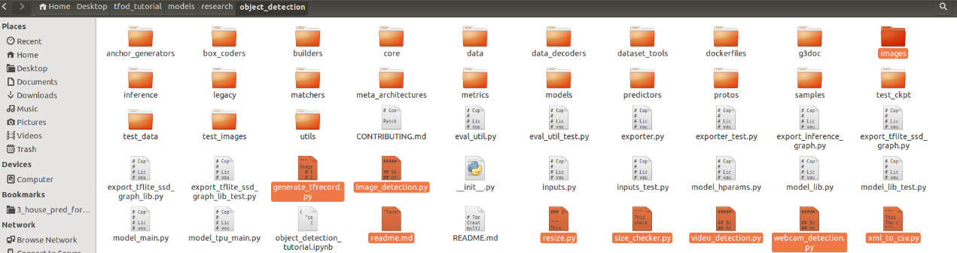
Setting up the directory structure
--after merging--

Slide 15
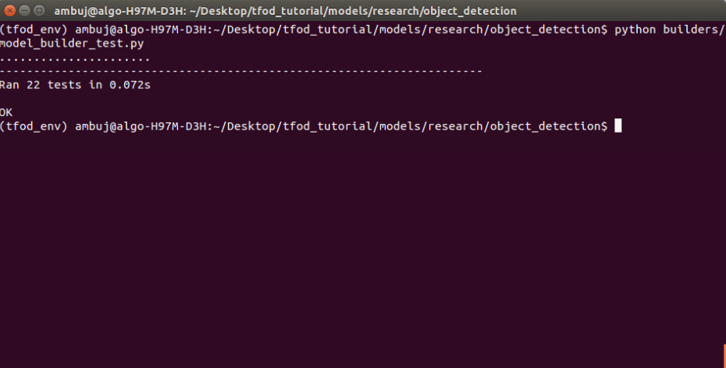
Setting up the directory structure
--resultant image--

Slide 16
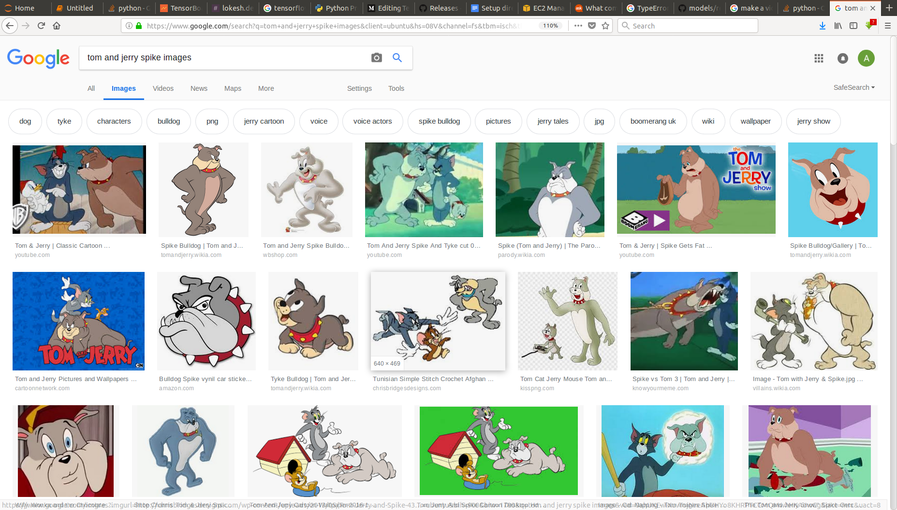
Preparing your custom data
--data collection--

Slide 17
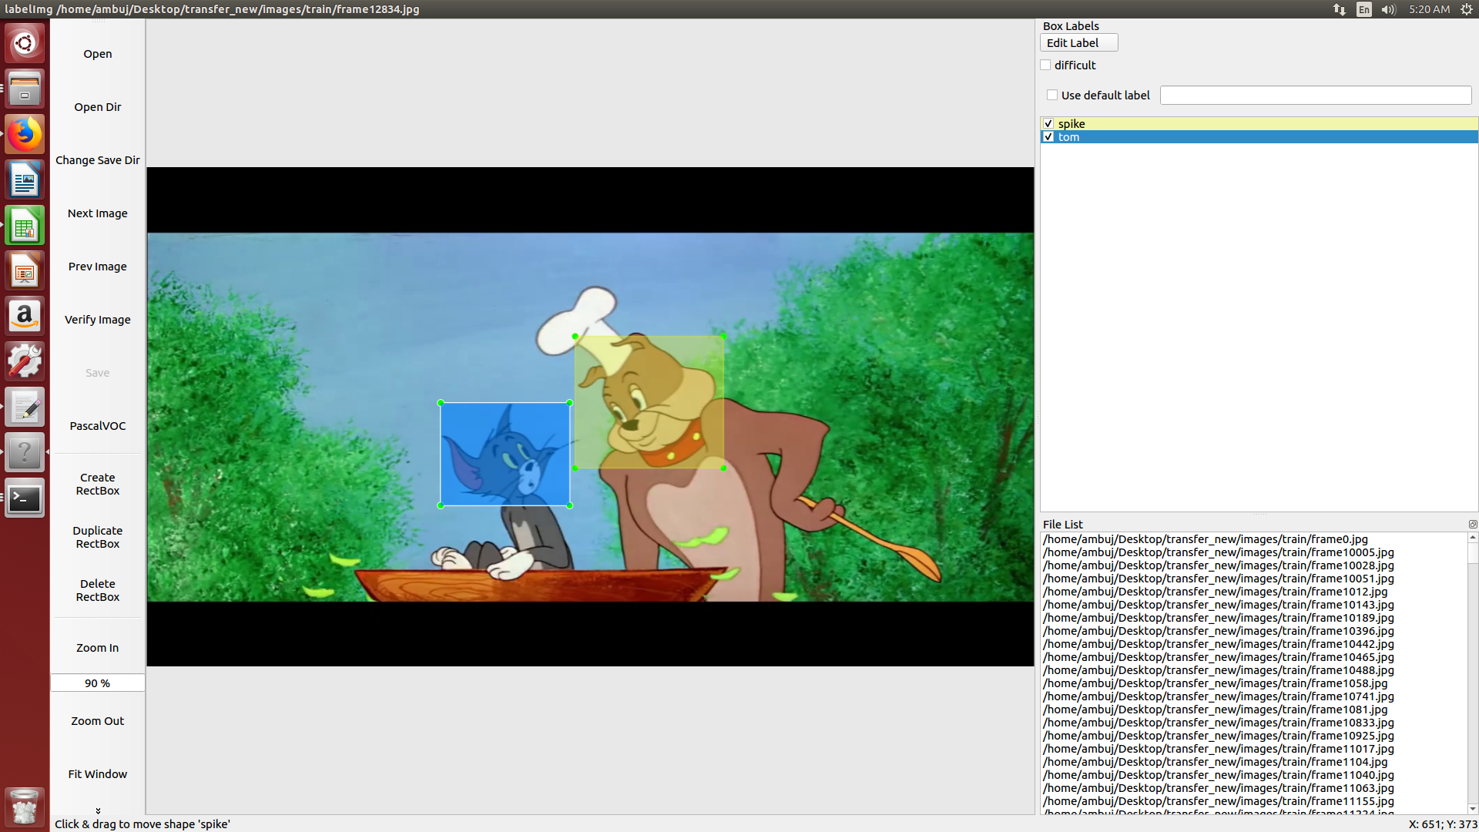
Preparing your custom data
-- lebelmg image--

Slide 18
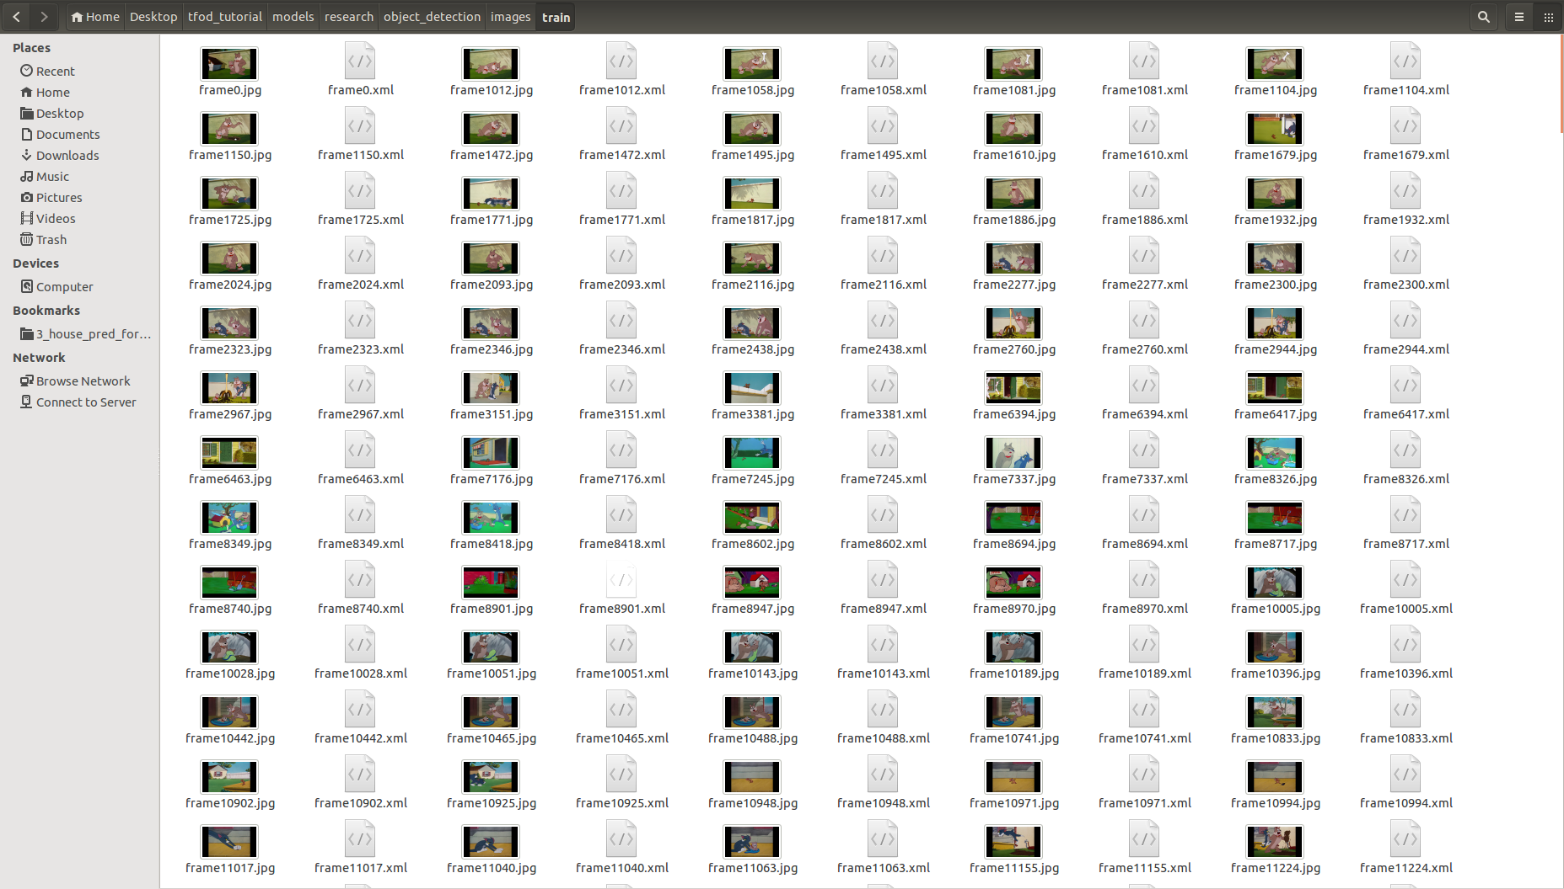
Preparing your custom data
-- xml generated--

Slide 19
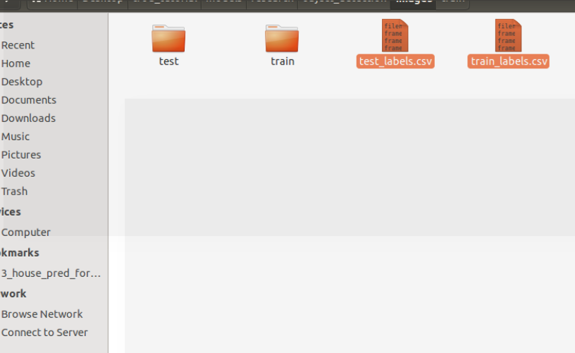
Preparing your custom data
--csv generated--

Slide 20
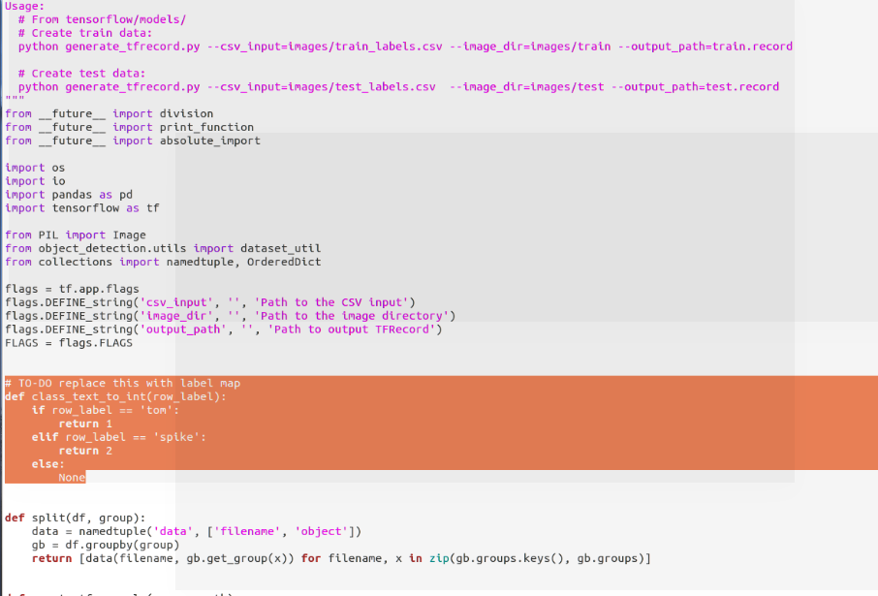
Preparing your custom data
--tfrecords--

Slide 21

Yeah! We’re halfway there!

Slide 22
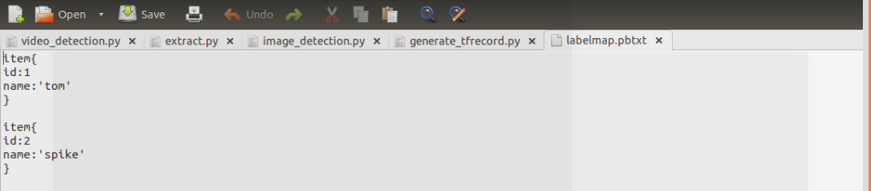
Initialising the Training
--labelmap--

Slide 23
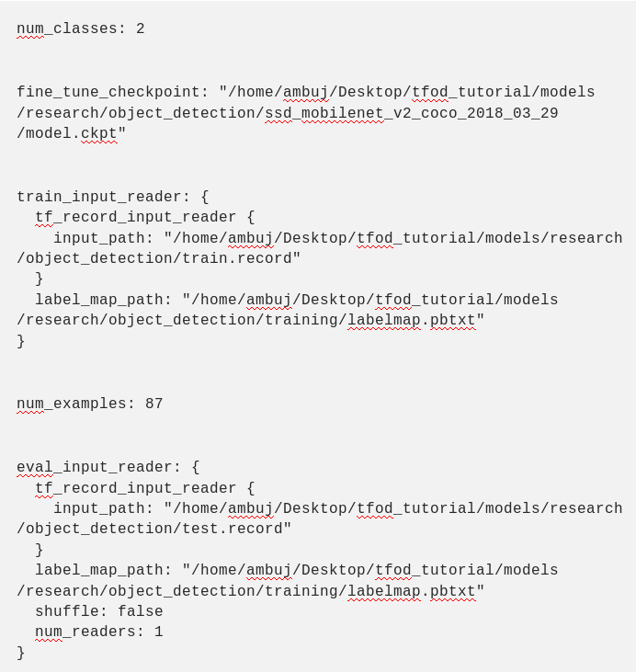
Initialising the Training

Slide 24
Let’s have a quick recap!
The protos folder must have a .pb2.py file for each of the .proto file.
You must have set the PYTHONPATH.
The images folder should contain the following:
test — contains the test images and test labels
train — contains the train images and train labels
test_labels.csv — csv file having the test labels
train_labels.csv — csv file having the train labels
The generate_tfrecord.py must contain the correct label map.
There must be train.record and test.record files in your object_detection folder.
The training folder should contain two files: labelmap.pbtxt and config file of the model.
The labelmap.pbtxt must contain the correct label map and the config file must have correct information according to your data.

Slide 25
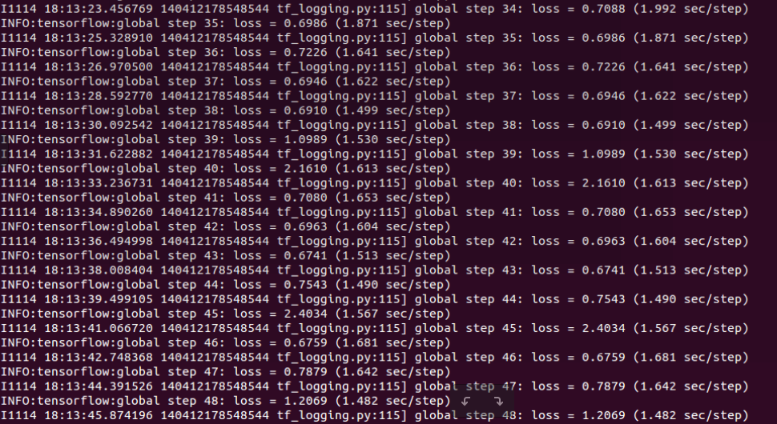
Initialising the Training
--training started image--

Slide 26
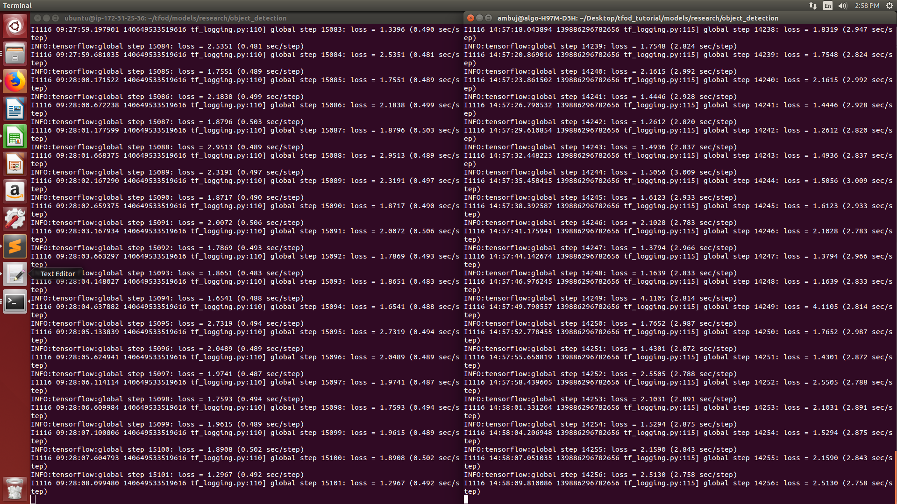
CPU vs GPU Training
--training started image--

Slide 27
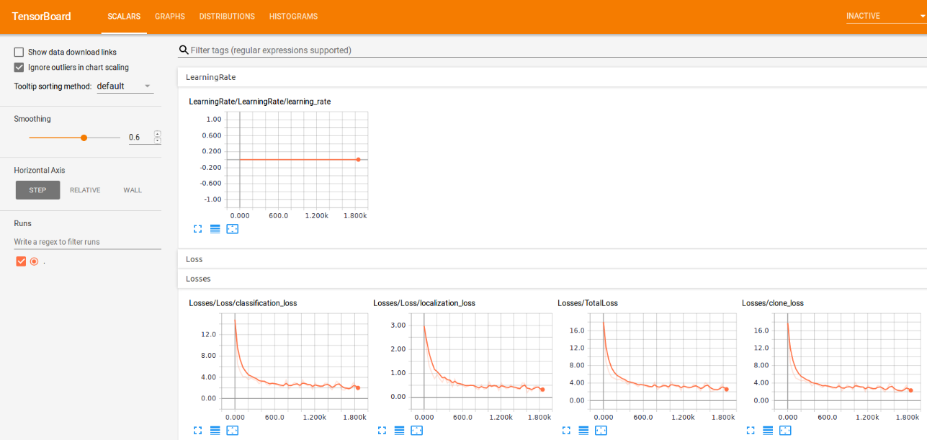
Tensorboard
--image--

Slide 28
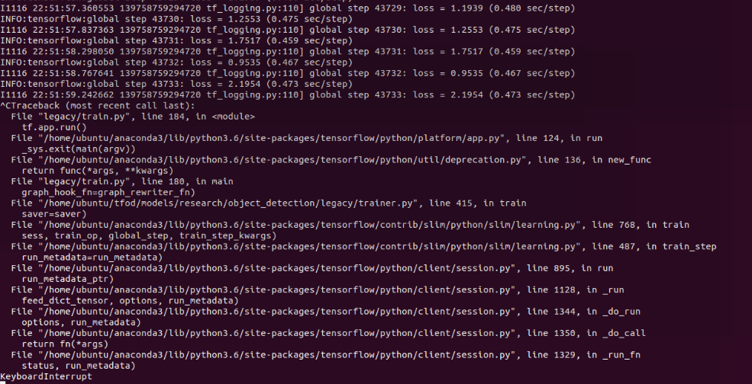
Convergence Point
--training ended image--

Slide 29
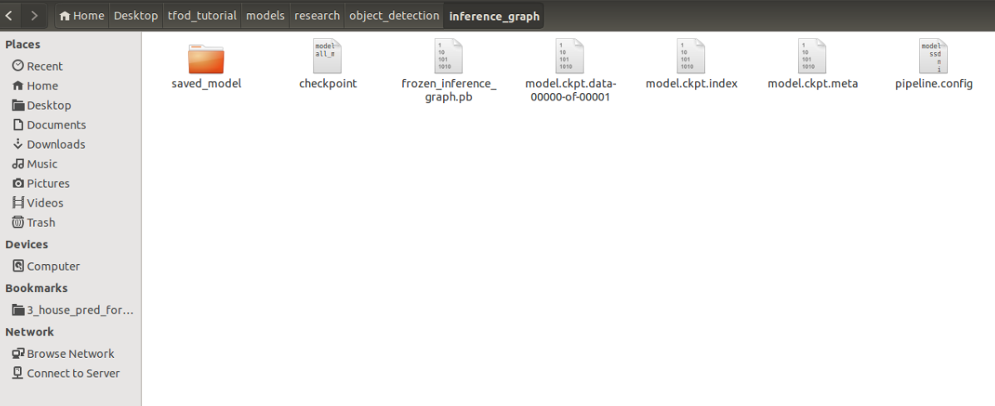
Detection on your custom data
--export inference graph image--

Slide 30
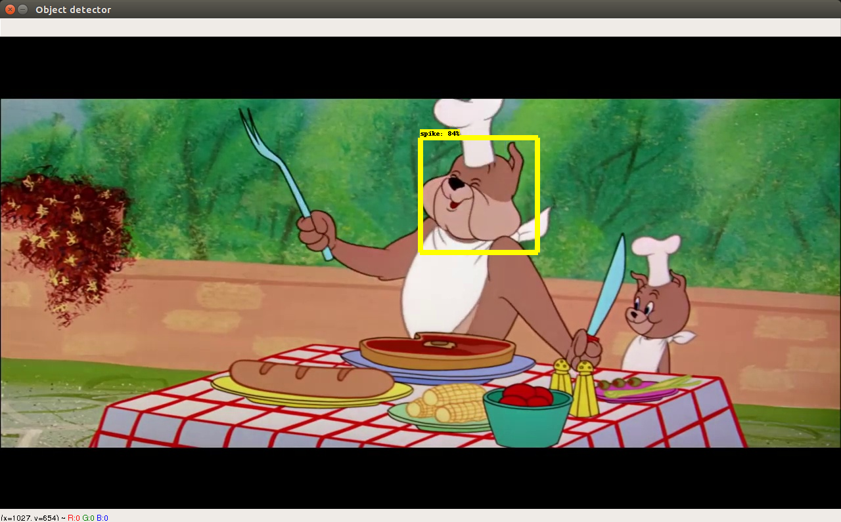
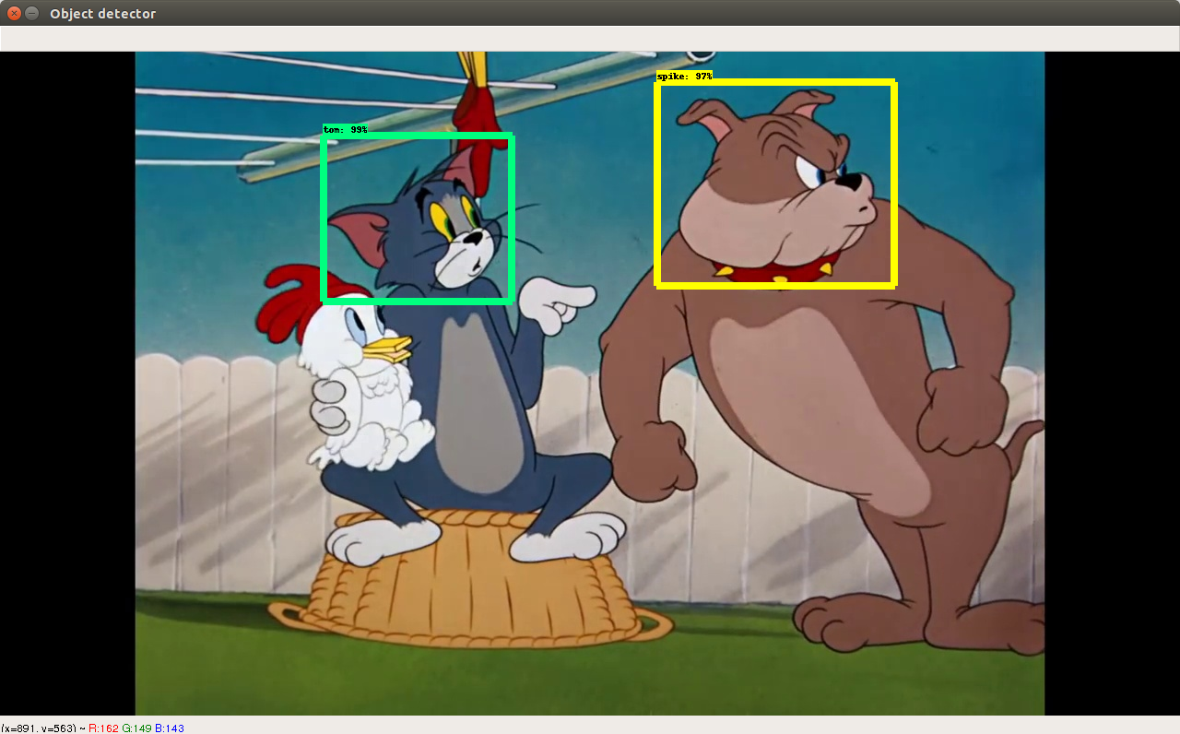
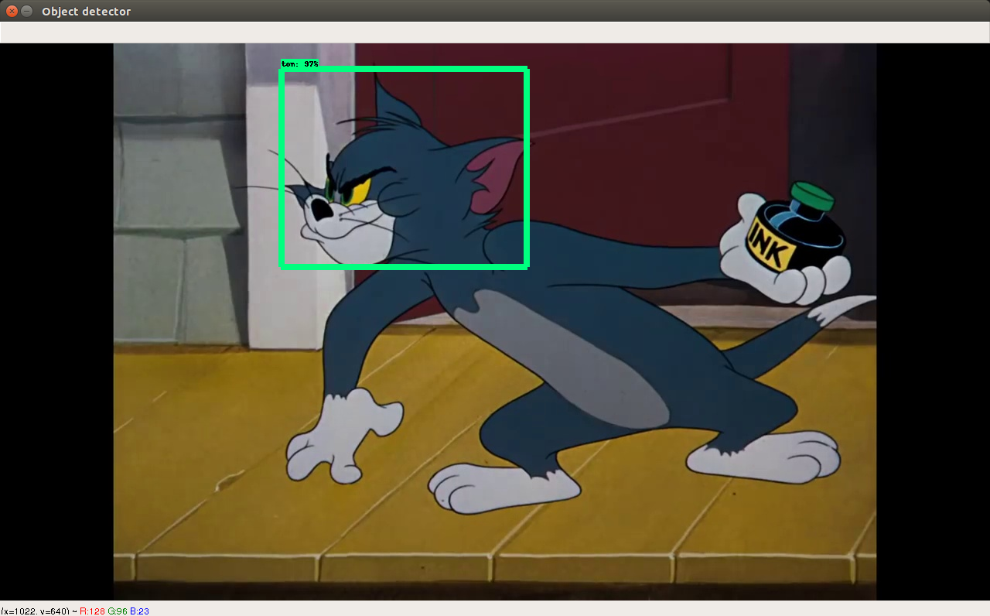
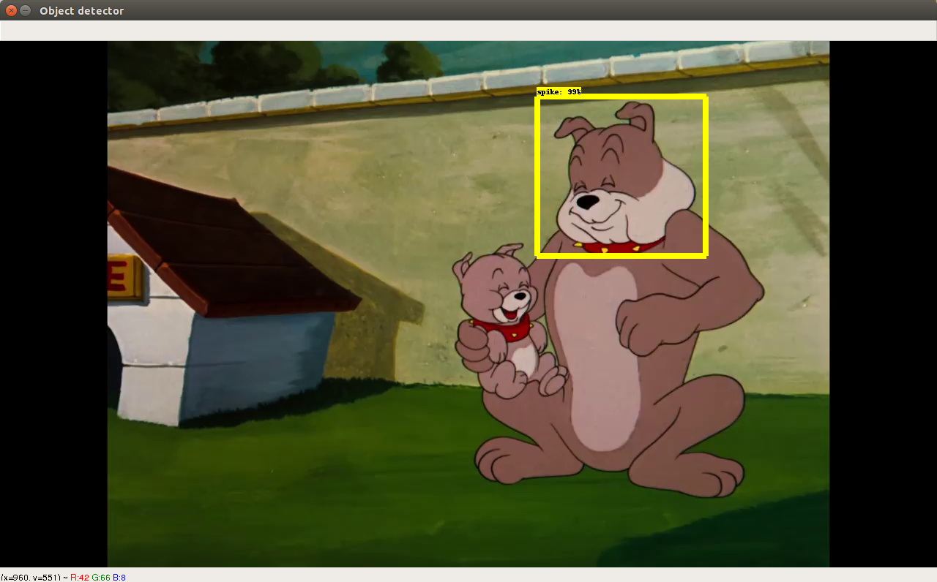
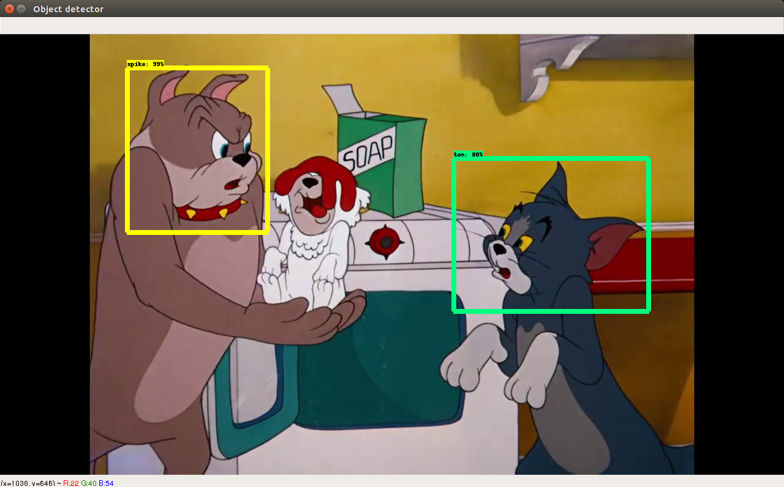
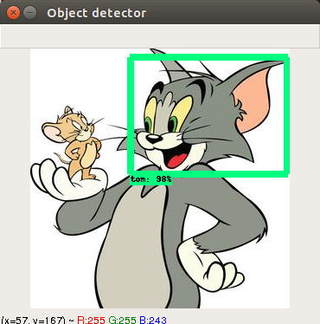
Detection on your custom data

Slide 31
References
https://www.tensorflow.org/tutorials/
https://github.com/tensorflow/models/tree/master/research/object_detection
https://www.slideshare.net/matthiasfeys/introduction-to-tensorflow-66591270
https://github.com/datitran/object_detector_app
https://www.analyticsvidhya.com/blog/2018/06/understanding-building-object-detection-model-python/
https://medium.com/@ar.ambuj23/tensorflow-object-detection-tutorial-by-making-a-tom-and-spike-classifier-part-1-setting-up-the-ba6826e1d3c5

Slide 32


Slide 33

Contact Me
Ambuj Arora
Email Id: ar.ambuj23@gmail.com
LinkedIn:
https://www.linkedin.com/in/ambuj-arora/
Github:
https://github.com/ar-ambuj23
Facebook:
https://www.facebook.com/Ambuj.23

